Slide 1
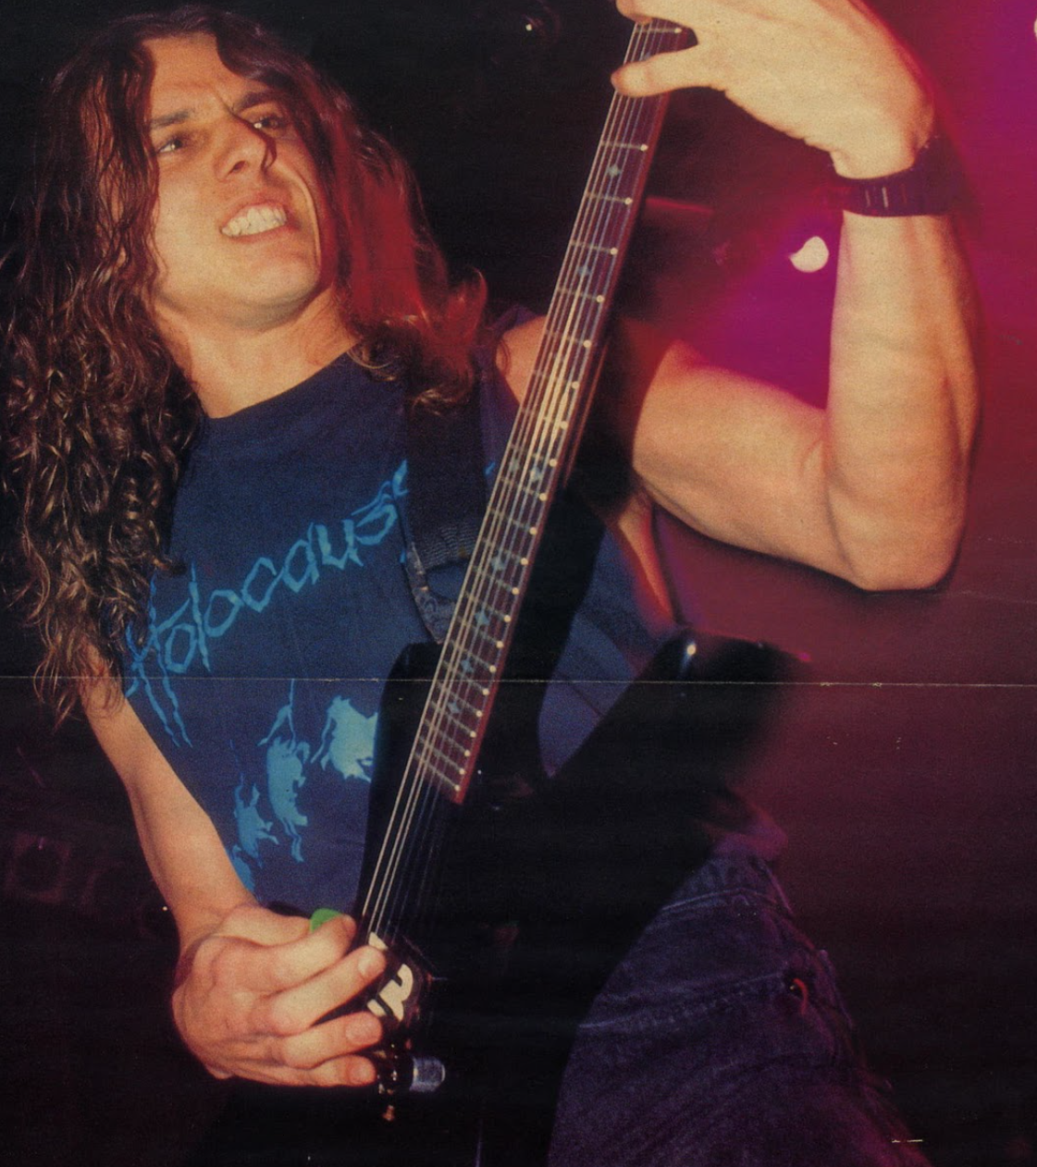
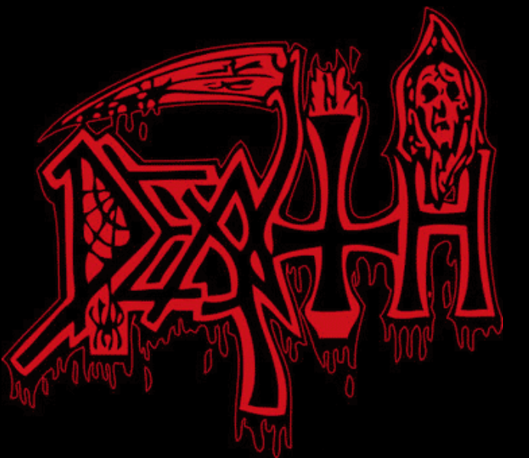
DEATH METAL WORLD

Slide 2


What is Death Metal Music???
Death Metal is a genre of metal composed of blast beats, crunchy and technical guitar riffs, intricate bass lines, and usually guttural vocal styles.

Slide 3


Analytical Skills
Technical domain: music.
Problem to solve: create a dashboard about death metal music.
Data availability: CSV files, Json Files.
----------------------------------------------------------------
My solution proposal: create a Dashboard.
What I'm going to deliver: Information and statistics about death metal music.

Slide 4
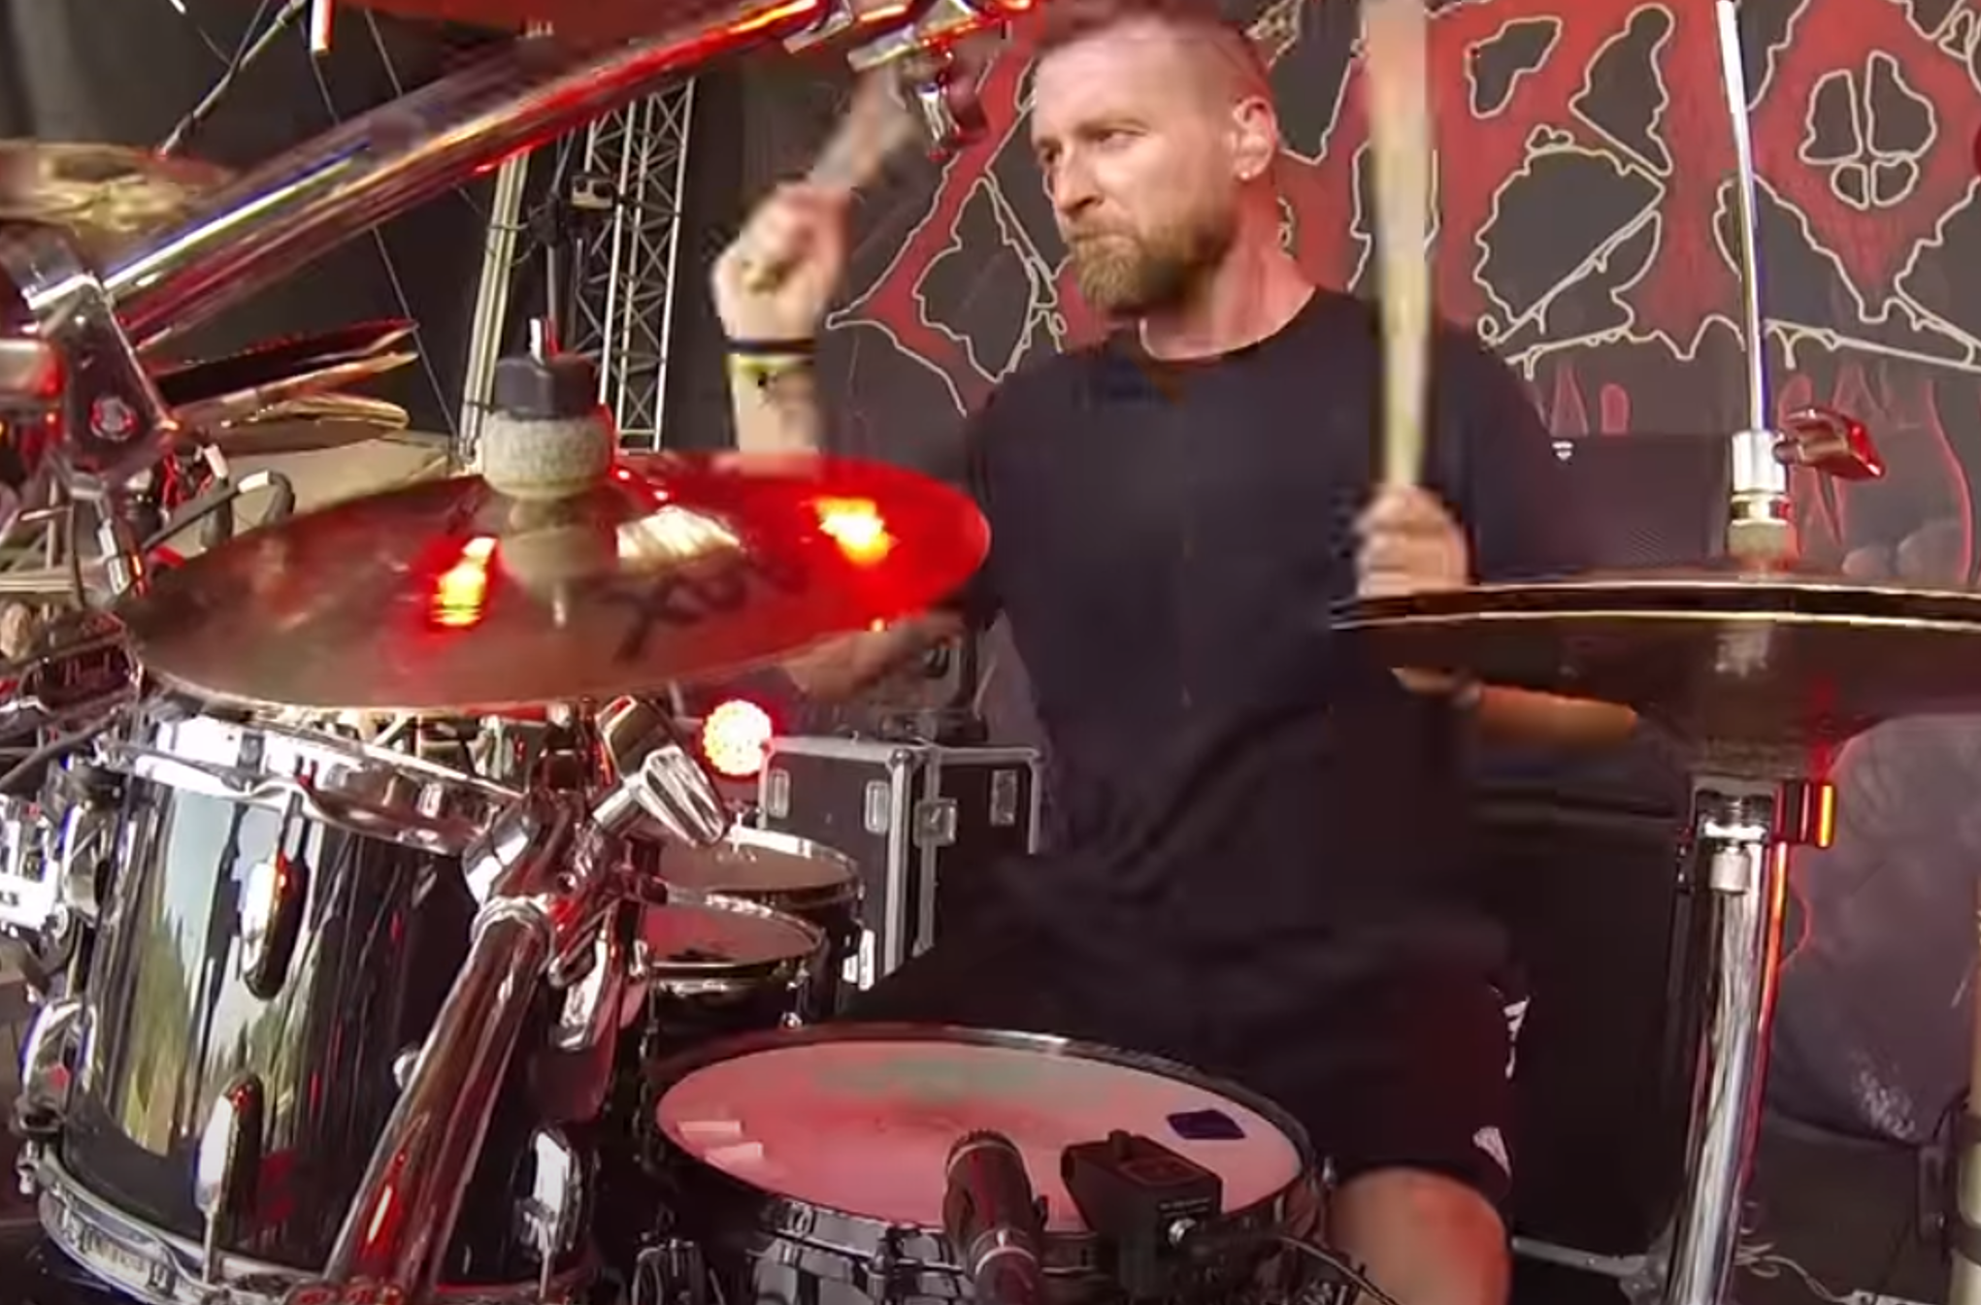

Technical Skills
Technical domain: python.
Main technical issue: data transformation and cleaning.
References: specialized websites, Spotify, own experience.
Data suitability: accessible.
----------------------------------------------------
Technology stack and resources: pandas, tableau.
Output (brick, difficulty): statistics.

Slide 5
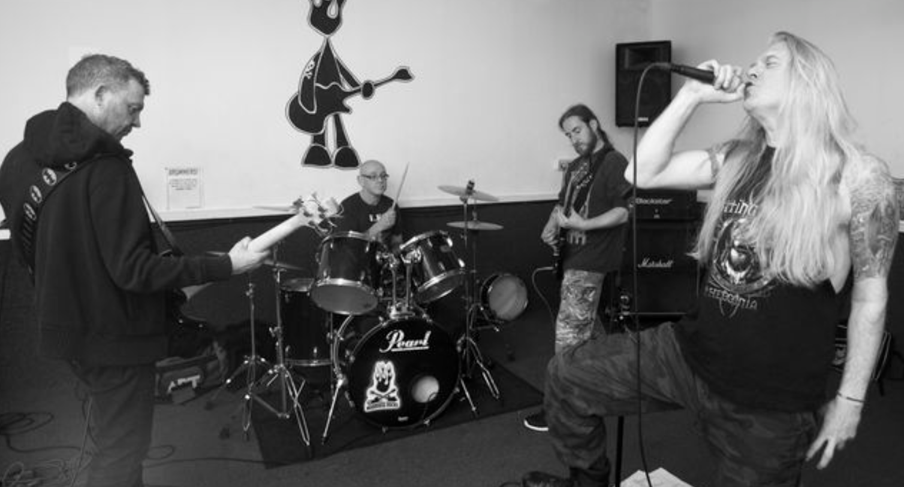
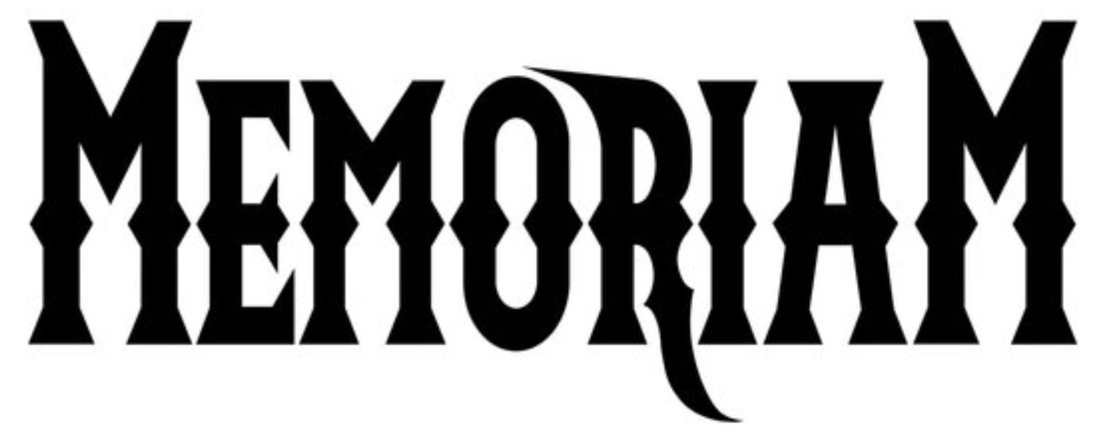
Project Architecture
Laptop
Json Files
Transformation
Extract
Load
CSV Files

Slide 6
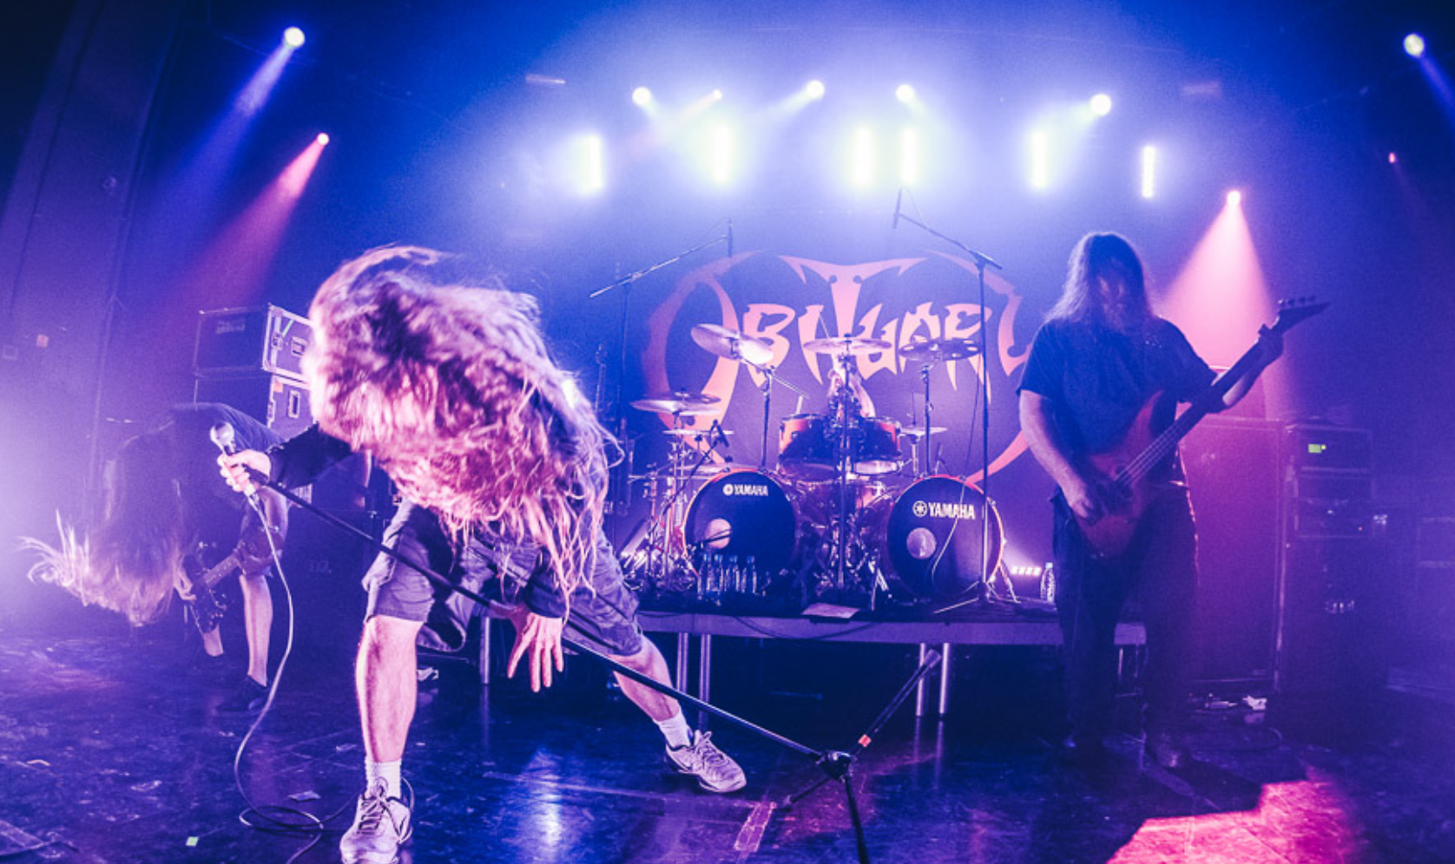

Project Elements
Data : Consolidated CSV and API.
Technology: Pandas, Numpy, Request, Tableau.
Output: Interactive Dashboard.

Slide 7

STAY BRUTAL 🤟🏽🎸🥁

